Slide 1
Computer Vision Interpretability
Making Models Trustworthy

Slide 2
What to Expect
By the end of this talk, you will understand
Why do we need Model Interpretability ?
What is model Interpretability ?
Types/Stages in improving model Interpretability ?
How to improve model accuracy using Interpretability ?
Experiments with model Interpretability
Toolkits for CV interpretability : Torch vision, Boilerplate codes in TF & Pytorch

Slide 3
What is model Interpretability
Being

Slide 4
Why Interpretability
Most of the models are judged based on accuracy metrics such as precision and recall of validation and test set.
While it is important to note the model accuracy scores, we have no way to check why the model responded the way it did.
Deploying any real-world safety-critical applications without understanding the models in depth can have unintended side effects.
Model Interpretability gives us the ability to understand the reasoning behind the model’s decision.

Slide 5
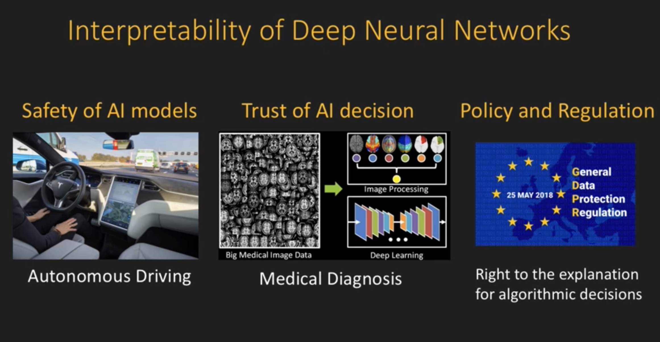
Stronger Case

Slide 6
Stages of Model Interpretability

Slide 7
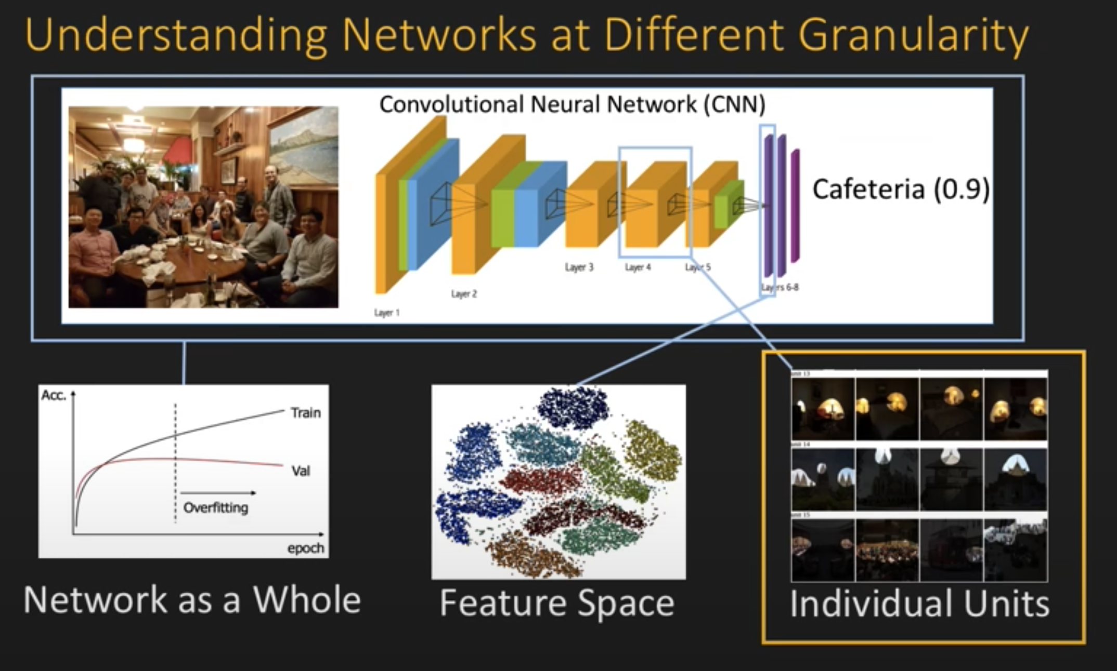
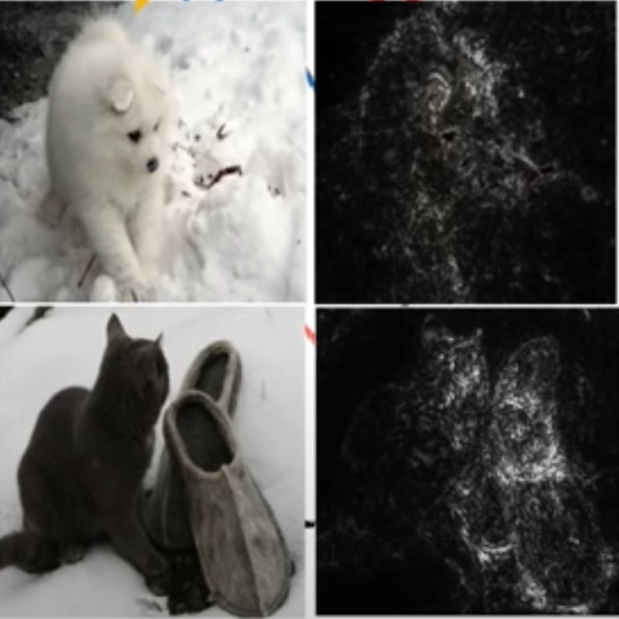
CV Interpretability techniques

Slide 8
CV Saliency - Comparison
GradCam
Full Grad
Integrated gradient
SmoothGrad
Input Gradient
Random

Slide 9
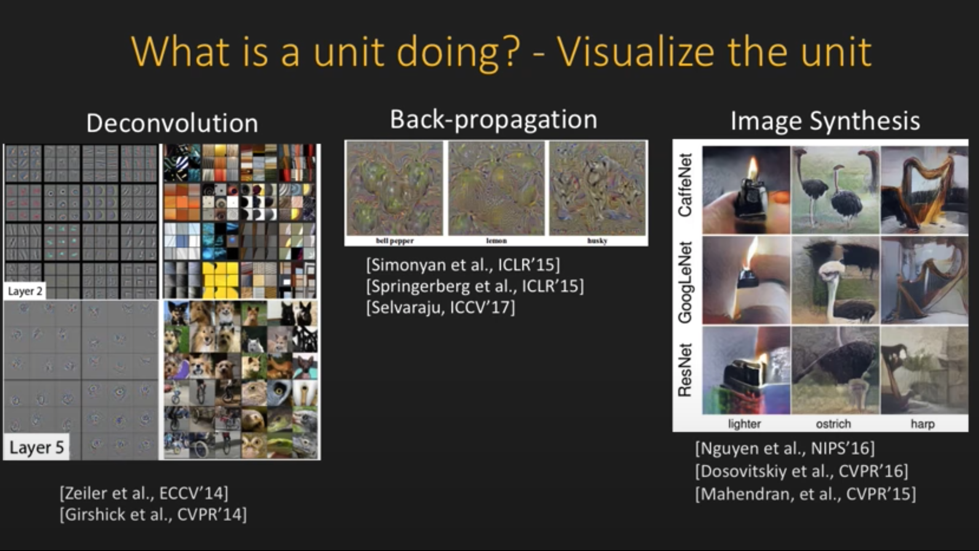
CV Interpretability techniques – Unitwise ananlysis

Slide 10
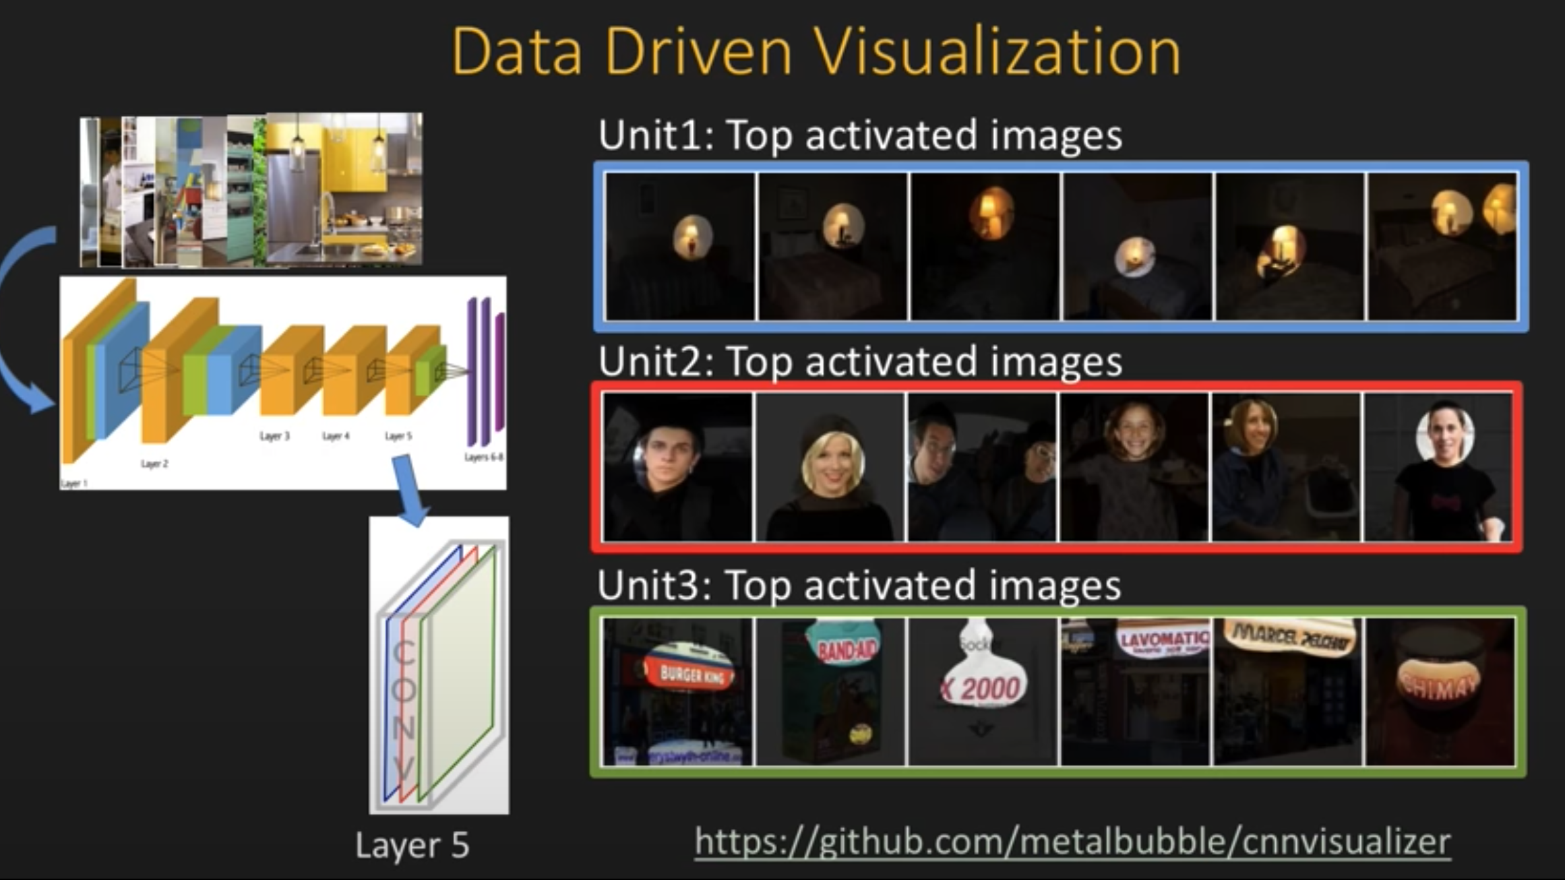
CV Interpretability techniques - visualization

Slide 11
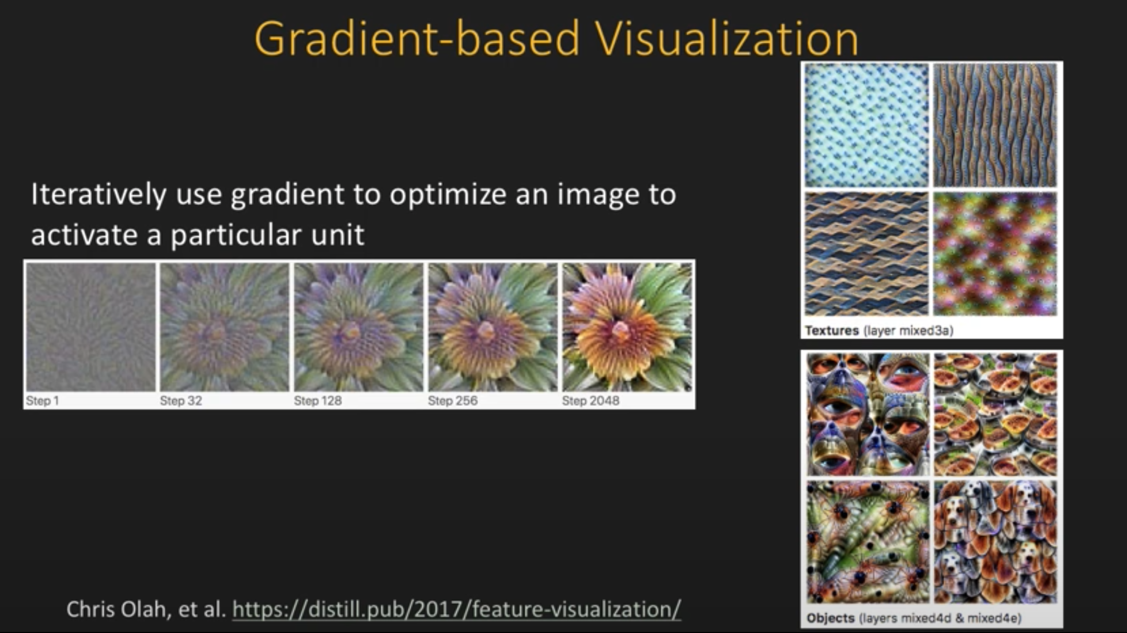
Gradient Based visualization

Slide 12
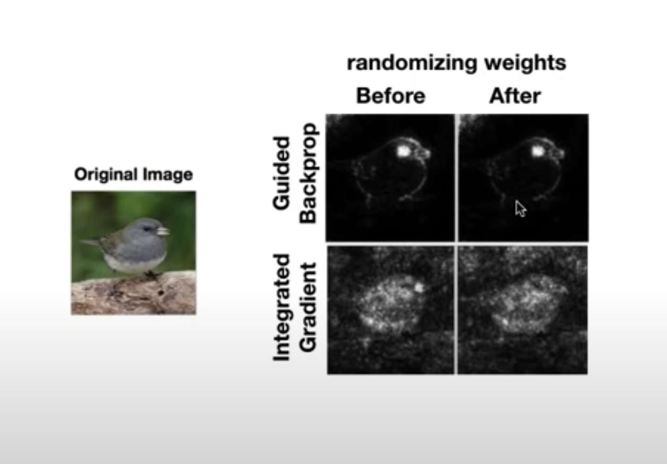
Experiments

Slide 13
Good Practices and ways to improve Model

Slide 14
Python in Use
Python + Jupyter notebooks comes in handy to generate and visualize saliency maps and intra model layers.
Generating special saliency map yard sticks and using those yard sticks to validate future model roll-outs is possible with the help of python pipeline.
It is easy to store the model evaluation results in Python data frame and analyze the reason for failure.
All of the functionalities in the proposed idea greatly rely on packages available in Python. The Pachyderm pipeline uses packages such as tensorwatch, tensorflow, pytorch, auto-sklerarn, hyperopt, Transformers, Tf-hub packages etc

Slide 15
Future Things
Python + Jupyter

Slide 16
Thank You!

